Slide 1
Module 1: Lesson 7 Generic Distributed Storage Systems and Execution Engines

Slide 2
Technology for Handling Big Data
Centralized storage and processing methods can no longer handle big data's volume and complexity
This has resulted in creation of new technologies capable of storing, managing, and processing massive volumes of data efficiently
Distributed storage and computation systems are two such technologies
Distributed storage systems stores data across numerous computer nodes (servers or virtual machines) rather than on a single workstation
Distributed computing systems refers to dividing a major workload into smaller sub-tasks and distributing them among several computer nodes in a network
[Source: https://ana.blogs.com/maestros/2006/11/data_is_the_new.html]

Slide 3
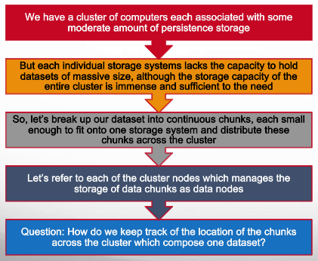
Generic Distributed Storage System (1)

Slide 4
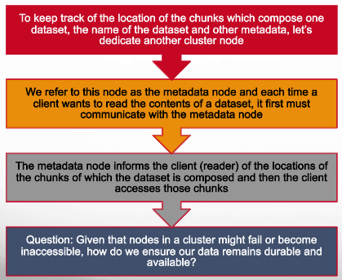
Generic Distributed Storage System (2)

Slide 5
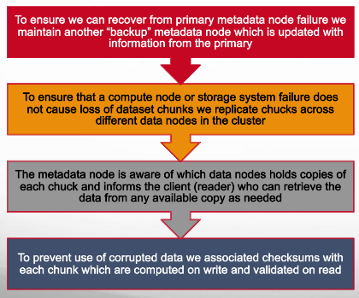
Generic Distributed Storage System (3)

Slide 6
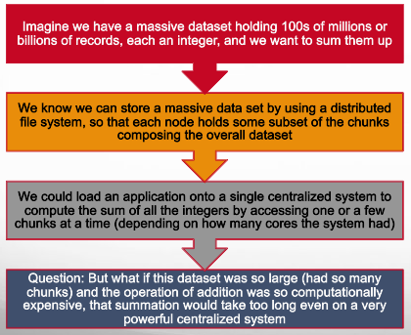
Generic Distributed Storage System (4)

Slide 7
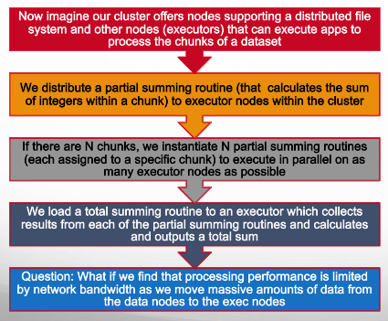
Generic Distributed Execution Engine (1)
4

Slide 8
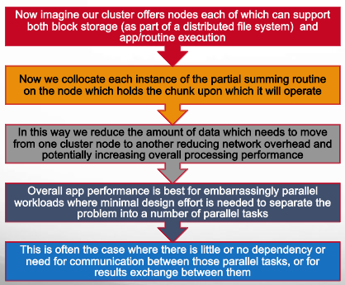
Generic Distributed Execution Engine (2)
4

